Slide 1
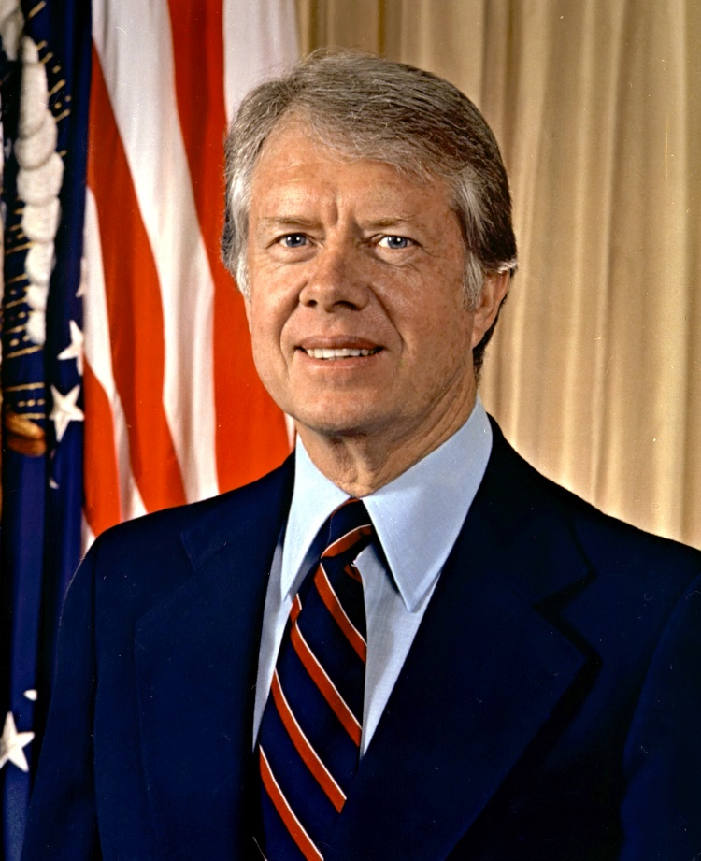
Topic 16: A Global Superpower Facing Change (1975-2000)
16.1: The Conservative Revolution pp. 860-869
I. Jimmy Carter won the Presidential election in 1976.
A. High inflation during Carter’s Presidency- cut government spending
B. Defended basic human rights- Helsinki Agreement
C. No aid to countries that violated human rights
https://www.youtube.com/watch?v=TmSO9pMWQjA
Carter presidency 1 ½ min

Slide 2
II. Crisis in the Middle East
A. Iranian Hostage Crisis- The US supported the Shah of Iran, who wasn’t a great ruler. He fled Iran during a revolution. The religious leader, Ayatollah Khomeini, took over. The Shah needed medical help from the US. The US allowed the Shah to come to the US for cancer treatment. Iranian revolutionaries (extremists) seized the US embassy in Tehran, Iran and took 53 US hostages in November 1979 until the end of Carter’s presidency in January 1981. Carter did try a rescue attempt, but it failed when US helicopters broke down over the Sahara Desert.
B. Energy crisis- high oil prices
C. Iran and Iraq at war with each other

Slide 3
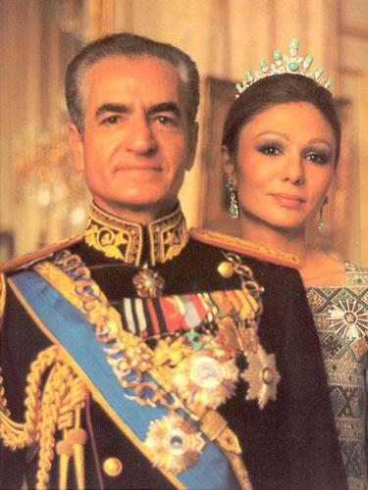
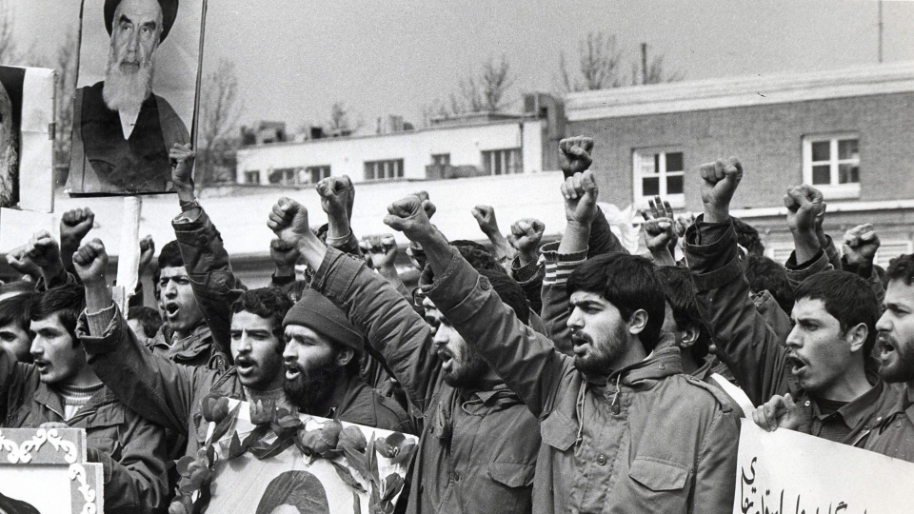
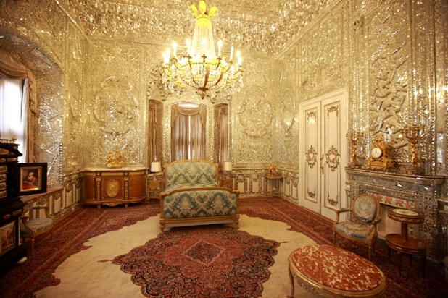
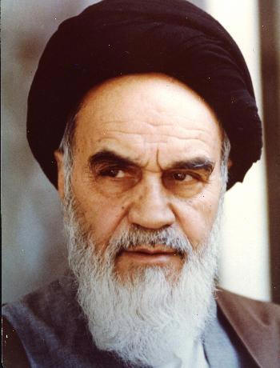
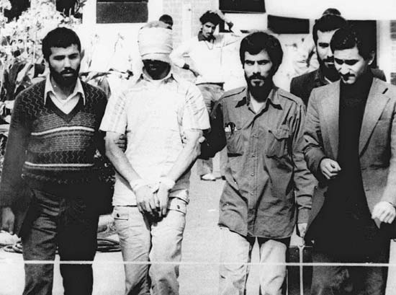
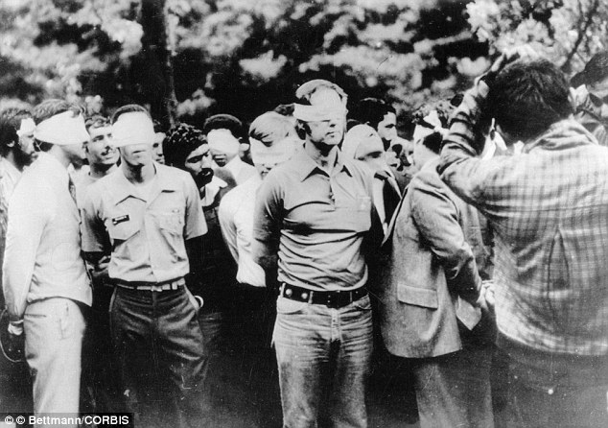
https://www.youtube.com/watch?v=vLgFQF28zQU
1.30 min
https://www.youtube.com/watch?v=-6Rt1a1xII8
3 min interview with Carter

Slide 4
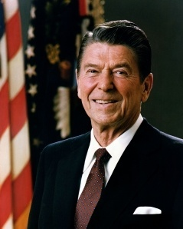
III. Ronald Reagan wins the 1980 and 1984 Presidential elections- called the Great Communicator
A. Return to traditional values- religion, family, and patriotism
B. Reganomics- cut taxes, so people would spend more
C. Spend less on federal programs- welfare and education
D. Deregulate business- opposed anti pollution laws
E. Cut social spending, but increased military spending- 1986 $240 billion deficit
https://www.youtube.com/watch?v=KzmrxK3BOSA
1 ½ min Reagan

Slide 5
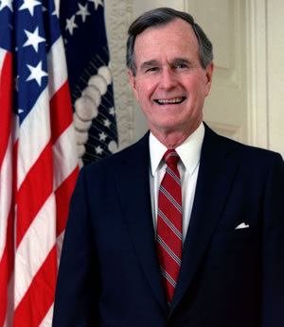
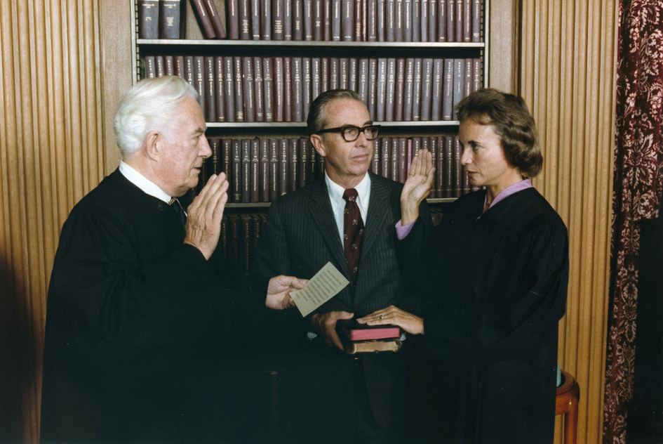
IV. 1988 George H.W. Bush wins the presidency promising to cut taxes
A. G.H.W. Bush increased taxes, so unpopular
B. Economy grew weaker, companies downsizing, US in a recession
C. Reagan appointed 1st female Supreme Court Justice- Sandra Day O’Connor
D. Bush appointed conservative judges too
https://www.youtube.com/watch?v=XBi-rFFkotQ
Bush 1 ½ min

Slide 6
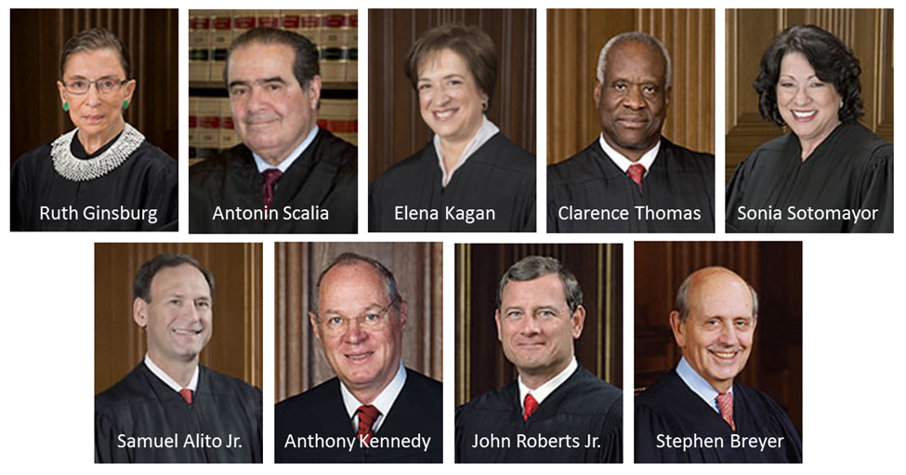
Antonin Scalia passed away last year. Donald Trump appointed Neil Gorsuch. Currently being questioned by Senate who has the authority to approve or disapprove the appointment.
Supreme Court Chief Justice: John Roberts

Slide 7
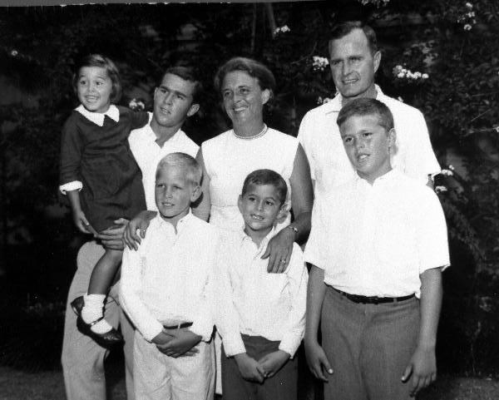

Slide 8
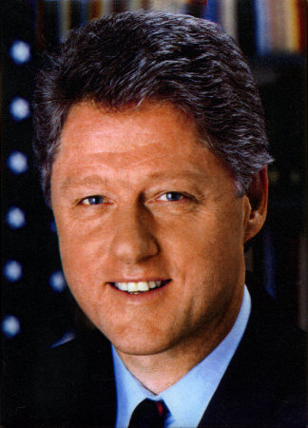
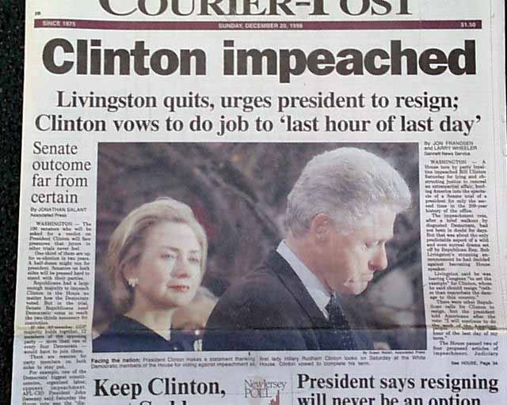
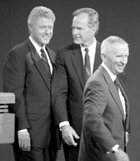
V. Bill Clinton wins the 1992 Presidential election against G.H.W. Bush and third party candidate Texas billionaire Ross Perot. (Republican vote split between Bush and Perot.)
A. NAFTA- North American Free Trade Agreement passed under Clinton- free trade between Canada, Mexico, and the U.S.
B. Economic boom under Clinton – balanced the budget and lowered the deficit- budget surplus
C. Clinton Impeachment Trial- Clinton lied under oath, so the House of Reps. voted to impeach him- the Senate tried him and acquitted him in 1999- 2nd president to go through full impeachment process

Slide 9
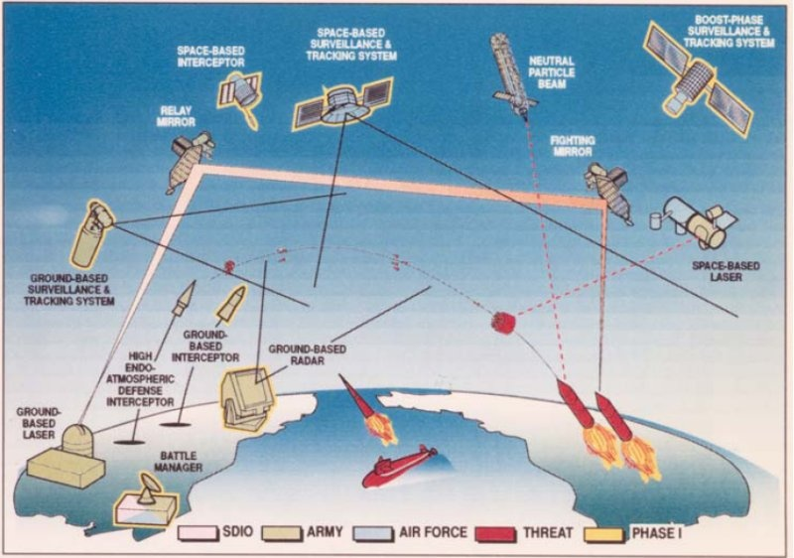
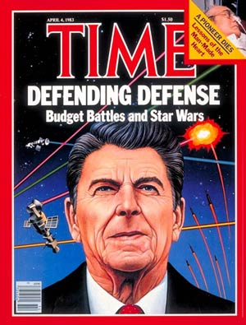
16.2: The End of the Cold War
I. End of Détente with the Soviet Union
A. Soviet Union invaded Afghanistan on southern border- US sent advisors and weapons to fight communism (Osama bin Laden)- Soviets left in 1989
B. US increased military spending under Reagan by more than $100 billion
C. Star Wars- defense system with US missiles destroying Soviet missiles in space
D. Soviets still dominate Eastern Europe- crackdown in Poland- martial law

Slide 10
II. Economic problems in the Soviet Union- little money and goods
A. Mikhail Gorbachev backed glasnost- speaking openly
B. US and Soviet summit meetings- agreed to dismantle short and medium range missiles
C. Communist Party only legal party in Soviet Union
D. Eastern Europe wanted democratic reforms- Soviet Union losing power
E. 1989 Poland has free elections- first in 50 years
F. One by one communist governments in Eastern Europe falls- Czechoslovakia, Hungary, Bulgaria, Albania, then Romania
G. Nov. 1989 the Berlin Wall falls- Germany reunites in 1990- joins NATO

Slide 11
III. Soviet Union was 15 different republics under the communist control of Moscow
A. Gorbachev weakened, resigns in late 1991
B. 15 new countries emerge from the former Soviet Union
C. Soviet Union has to rebuild a free market economy- Boris Yeltsin is elected as Russian leader
D. Democratic countries emerge in former Soviet controlled areas- many join NATO later
IV. The Aftermath of the Cold War- from 1946-1990 US spent $6 trillion in defense
A. Clinton spent less on military
B. US thought they were free from external threats
https://www.youtube.com/watch?v=hc2XGHA7NK4
Fall of Communism in Eastern Europe 6 min.
https://www.youtube.com/watch?v=j-2kx549Mf0
Fall of Communism in Soviet Union 7 min.

Slide 12
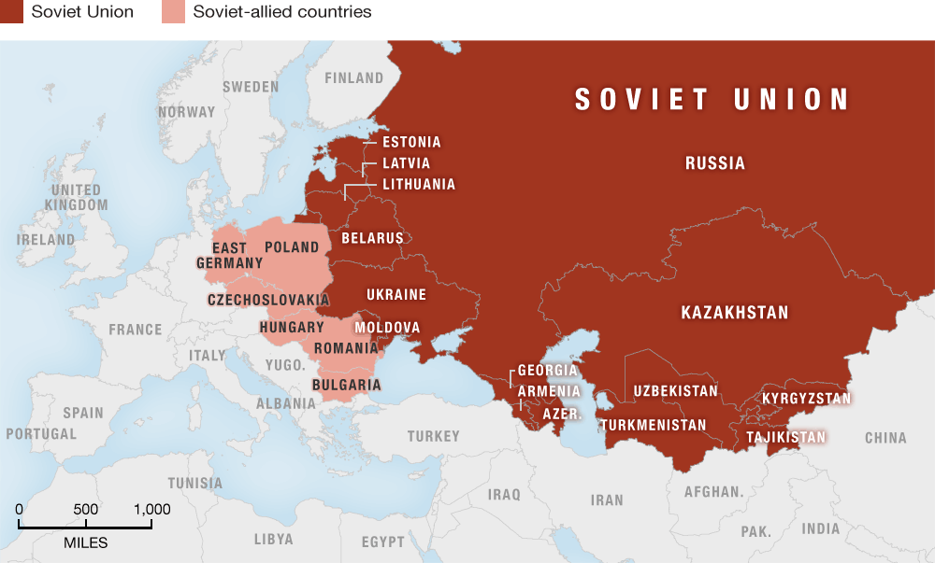

Slide 13
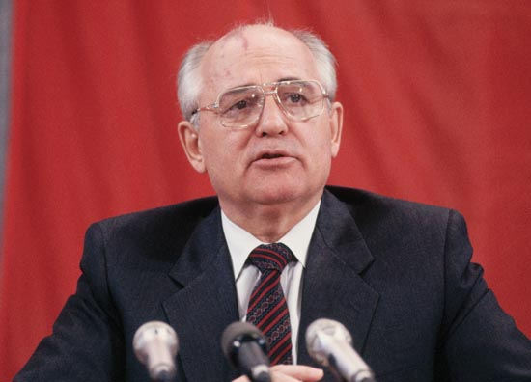
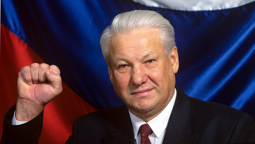
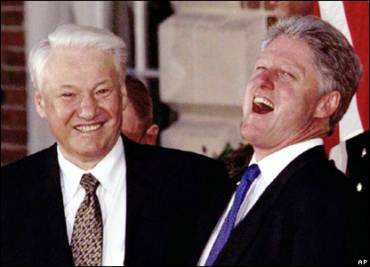
Mikhail Gorbachev- last communist Boris Yeltsin- first noncommunist
Leader of the Soviet Union Leader of Russia

Slide 14
6.3 Regional Conflicts
I. The US and Soviet Union agreed to reduced nuclear weapons- START- Nations refused to sign the Nuclear Nonproliferation Treaty- Israel, India, and Pakistan have nuclear weapons- Pakistan shared nuclear information with North Korea
II. Democracy reforms
A. The Philippines elected female president, Corazon Aquino in 1986, after US backed dictator Ferdinand Marcos fled (he was anticommunist).
B. Tiananmen Square Protests in China in May- June 1989- Students staged a pro democracy demonstration in Beijing. The Army squashed it- hundreds were killed and thousands sent to prison.

Slide 15
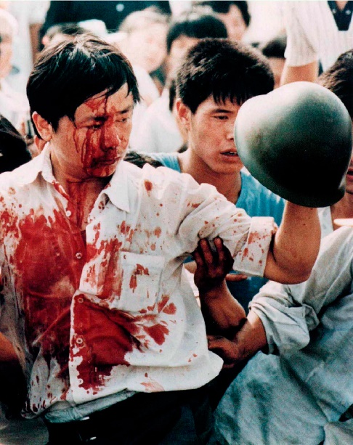
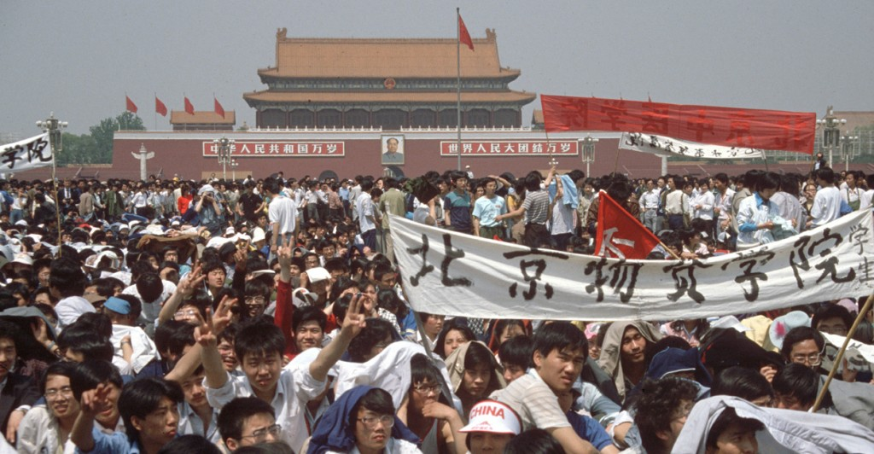
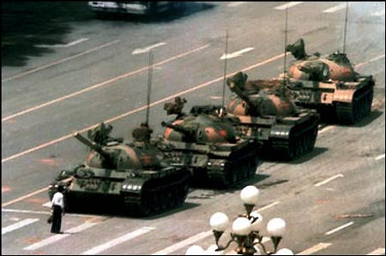
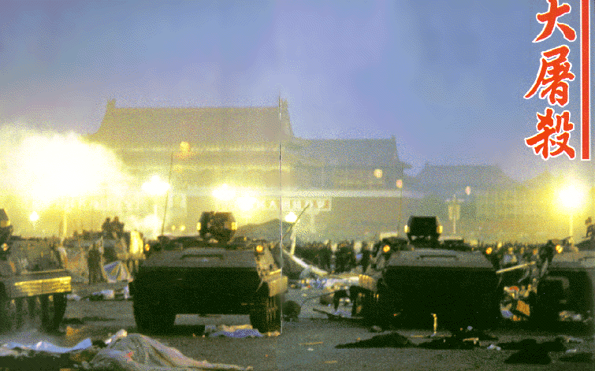
Tiananmen Square protests began May 19, 1989- June 3-4 1989 government sent to stop protests- hundreds were killed, 10’s of thousands jailed.
https://www.youtube.com/watch?v=YeFzeNAHEhU
Tiananmen square massacre 2.50 min
https://www.youtube.com/watch?v=kMKvxJ-Js3A
BBC news Tiananmen protests 3.37 min

Slide 16
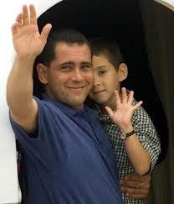
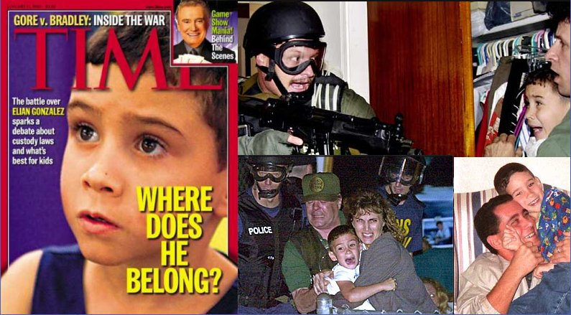
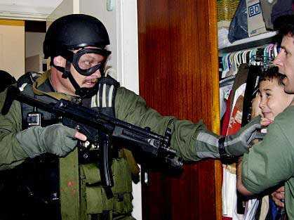
C. Cubans fled by boat to the US to flee dictator Fidel Castro’s Cuba.
https://www.youtube.com/watch?v=N0ki3Jb5oiQ
2 min CBS review
https://www.youtube.com/watch?v=oozJpVGNkVI
3 min. current video

Slide 17
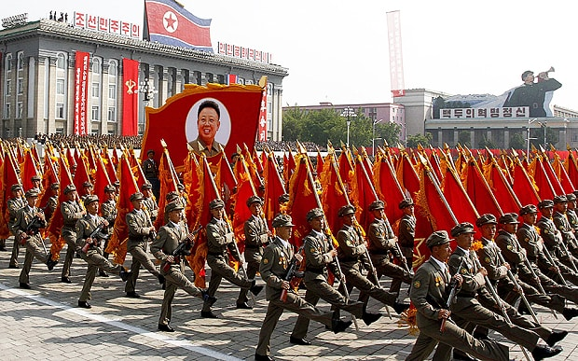
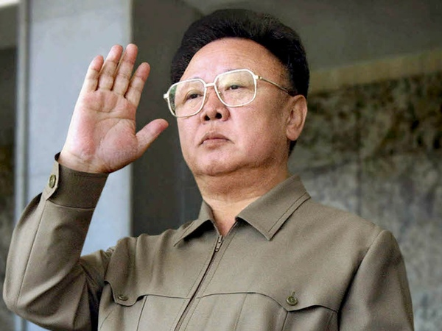
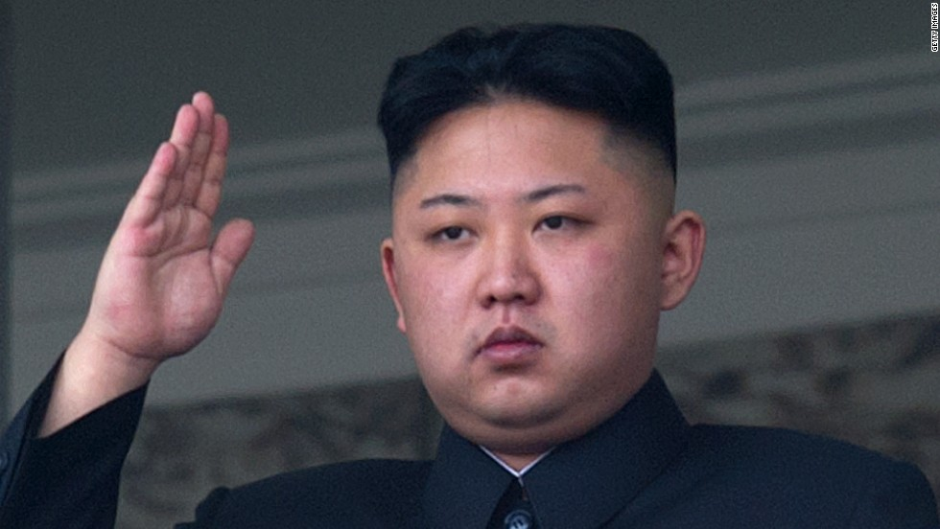
D. North Korean famine- brutal dictatorship under Kim Jong Il.

Slide 18
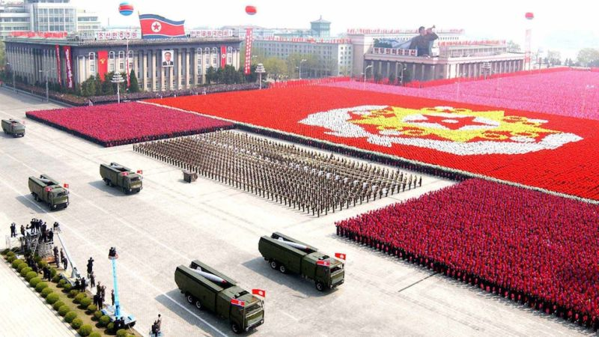

Slide 19
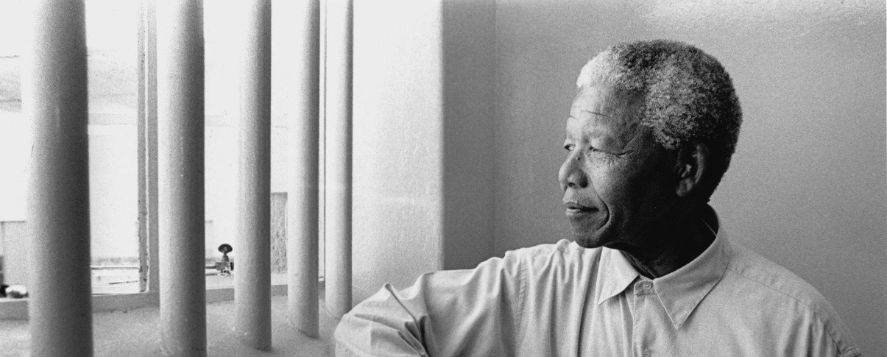
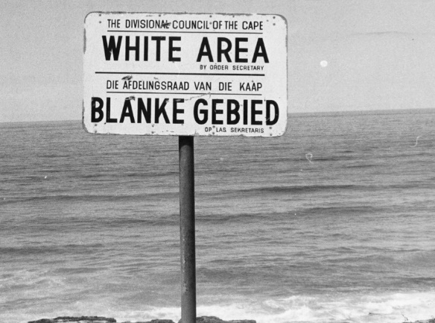
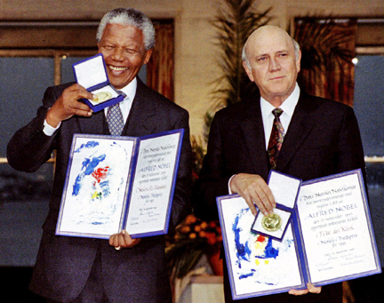
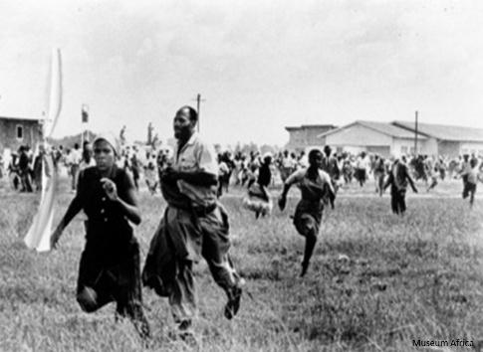
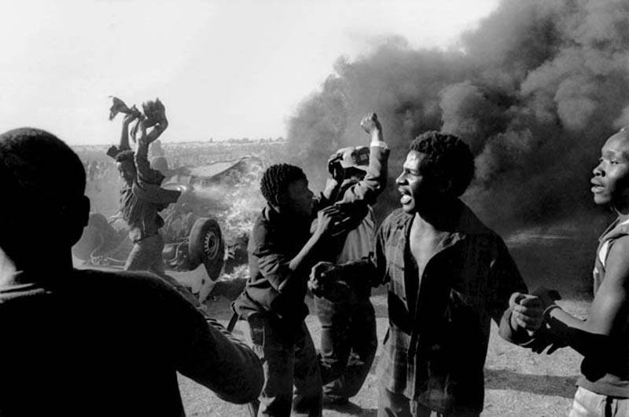
E. Since 1948 South Africa used a policy of apartheid- strict segregation- the nation’s nonwhite majority was segregated and had no voice in government. US had economic sanctions against South Africa- they moved to end minority rule. Nelson Mandela was freed after 27 years and won the 1994 Presidential election. He opposed apartheid.
https://www.youtube.com/watch?v=2f2k6iDFCL4
BBC 1 ½ min
https://www.youtube.com/watch?v=n2EvZ8cYcC8
3 min Protests of apartheid
Nelson Mandela and F. W. De Klerk win
Nobel Peace Prize in 1993.

Slide 20
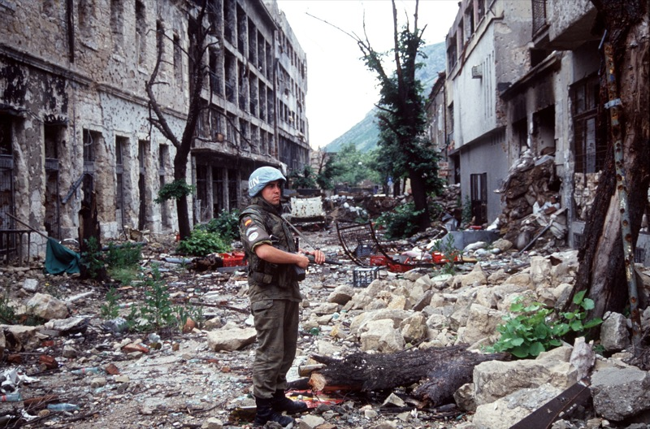
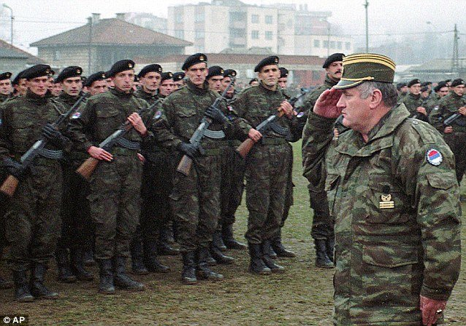
III. Eastern Europe and Russia hard economic times building a stable democracy.
A. Bosnian Civil War- many died- new countries- Croatia, Serbia, Bosnia- Herzegovina
B. US troops sent to Serbia to help the Albanians in Kosovo region- ethnic cleansing

Slide 21
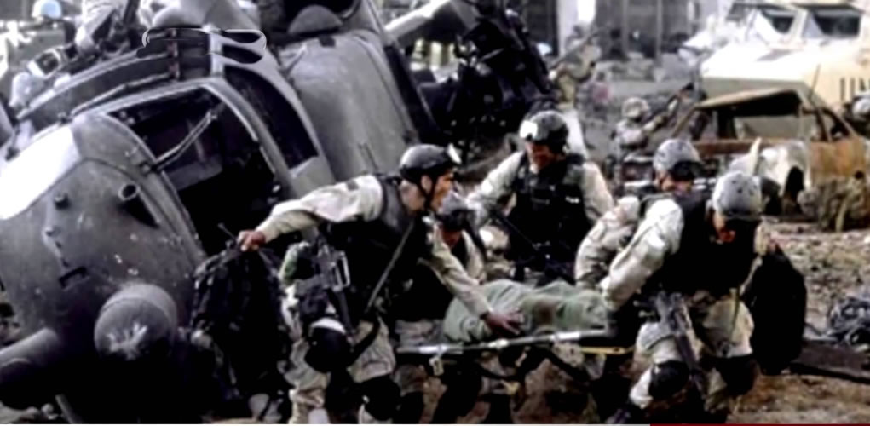
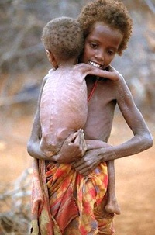
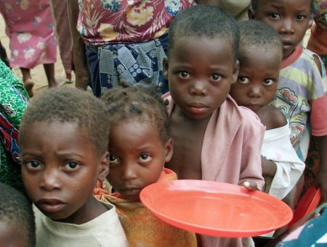
IV. Civil Wars in Latin America- US backed anti communist leaders- even dictators
A. Nicaragua 1979- US backed the Contras against socialist Sandinistas fearing communism- Congress voted to not give aid, high ranking military sold arms to Iran and funneled the money to the Contras. Reagan officials were tried and convicted.
B. Battle of Mogadishu- Blackhawk Down in Somalia- Special Operations to restore order- civil war and famine- 18 Army Rangers killed.
C. Ireland wanted to reunite with Northern Ireland governed by Britain- fighting and deaths- Good Friday Agreement signed in 1998 between Ireland and Northern Ireland
https://www.youtube.com/watch?v=O1uvpakorog
Black Hawk Down 2 ½ min Nat. Geographic

Slide 22
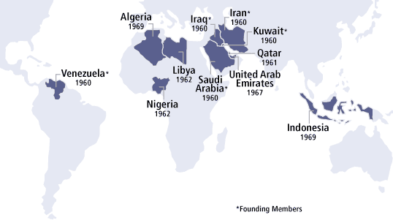
V. Middle East conflicts- US supports Jewish state of Israel, but relies on Middle Eastern oil
A. After WWII, the UN helps Jews relocate to a Jewish State (Israel)- Arab Palestinians live there. 1948- Jews announce the Jewish state of Israel. Arab-Israeli Wars in 1948, 1967, 1973- Israel took control of Palestinian territory. The US sent aid to Israel and OPEC (Organization of Petroleum Exporting Countries) cut off oil shipments to the US. They lifted the embargo in 1974.

Slide 23
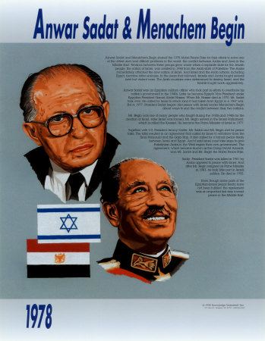
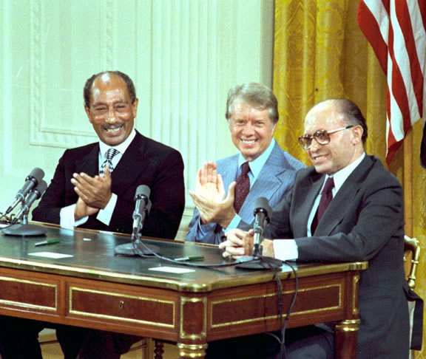
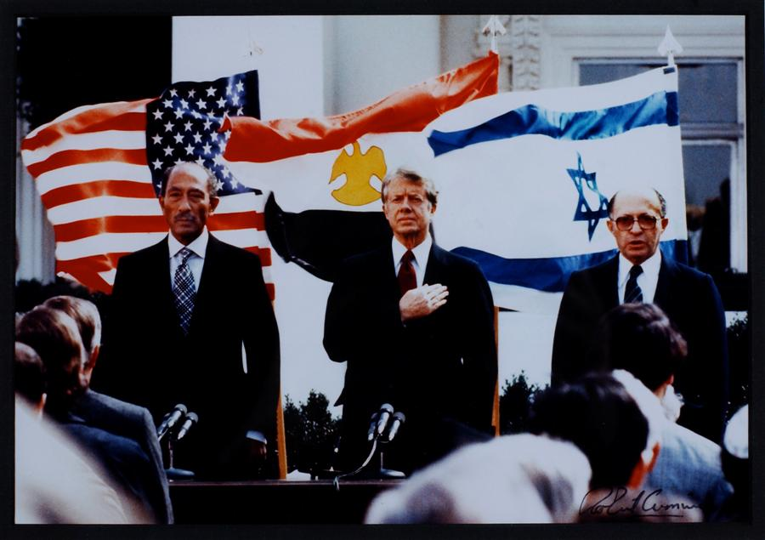
B. Egyptian President Anwar Sadat met with Israeli Prime Minister Menachem Begin at Camp David in the US with President Carter. Sadat and Begin signed the Camp David Accords in 1979. Israel returned the Sinai Peninsula to Egypt and Egypt was the first Arab country to recognize the nation of Israel. Anwar el Sadat and Menachem Begin won the Nobel Peace Prize. Sadat would be assassinated by Egyptians upset by his signing the Camp David Accords recognizing Israel.

Slide 24
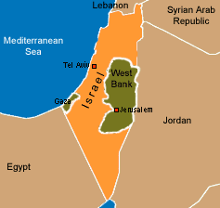
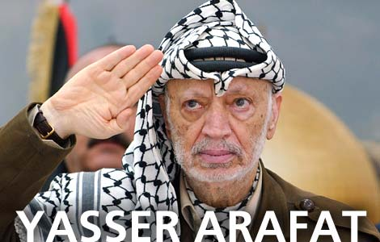
C. Some Palestinians waged guerilla warfare against Israel- suicide bombings. Many Palestinians living in Israel’s control had limited rights, those living outside of their homeland wanted to return. Yasser Arafat led the PLO- Palestine Liberation Organization- wanted to destroy Israel. There were many protests. Israel and the PLO signed an agreement in 1993.

Slide 25
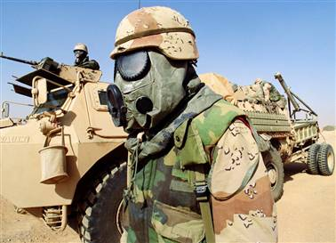
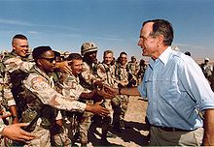
VI. The Persian Gulf War
A. August 1990- Saddam Hussein- Iraqi dictator sends 100,000 troops to oil rich Kuwait- US and UN demand Iraq leave- trade boycott on Iraq. US and UN (from 28 countries including Arab countries) launch airstrikes. Iraq left Kuwait 6 weeks later- lighting oil field on fire.
B. UN boycott continued against Iraq to force Saddam Hussein to stop his chemical and biological weapons programs. Hussein refused to cooperate with UN arms inspectors.
https://www.youtube.com/watch?v=l2TQ8a4LK3A
5 min Persian Gulf war

