Slide 1
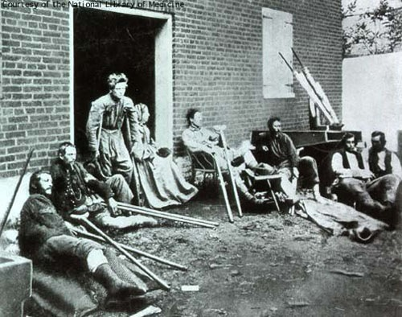
Topic 9: The Reconstruction Era
9.1 Early Reconstruction
I. Civil War years – 1861-1865
A. 800,000 returning Northern soldiers needed jobs.
B. Very few battles on Northern soil
C. Many wounded soldiers
D. Disagreement on how to let the South reenter the Union

Slide 2
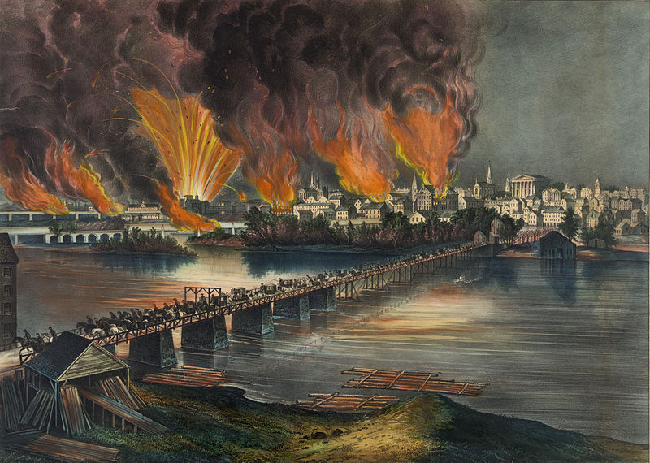
E. South- whole towns, homes, farms, bridges, railroads etc… destroyed
F. Confederate money worthless- banks closed, people lost their lifesavings
G. What would happen to the newly freed slaves- freedman
H. Northern economy built up while the South struggled to rebuild.
By Currier & Ives (not signed) - This image is available from the United States Library of Congress's Prints and Photographs division under the digital ID pga.03629.This tag does not indicate the copyright status of the attached work. A normal copyright tag is still required. Public Domain, https://commons.wikimedia.org/w/index.php?curid=39376890

Slide 3
II. Reconstruction: Ten Percent Plan- Southern state could form a new government after 10% of its voters swore an oath of loyalty to the US and slavery must be abolished by new state gov’t.
A. Freedman’s Bureau helped the freed slaves with medical, finding jobs, setting up schools…
B. Abraham Lincoln assassinated by John Wilkes Booth on April 14, 1865 at Ford’s Theater.
C. Booth caught and hanged by a mob. 4 other conspirators were hanged- Mary Surratt.
D. 13th Amendment- abolished slavery
E. President Andrew Johnson approved Southern new state governments that met conditions. Republicans from the North upset that the South was let back in the gov’t so easily.

Slide 4
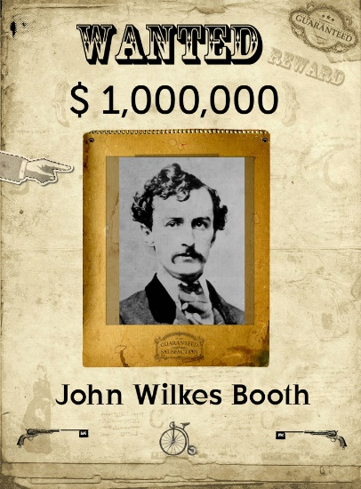
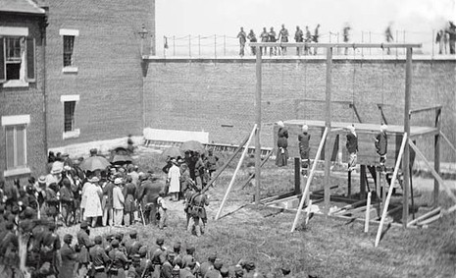
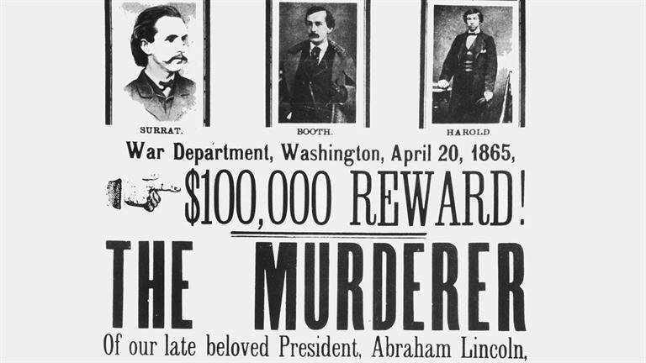
http://www.history.com/topics/abraham-lincoln-assassination/videos/abraham-lincoln-death-threats?m=528e394da93ae&s=undefined&f=&free=false
2 min. Lincoln death threats History Channel
Booth Diary 3 min. History Channel
Motives of Booth 4 min. Hist. Channel
Mary Surratt (far left) and the other convicted conspirators on the gallows. Mary became the first woman in American history to be executed by the federal government.

Slide 5
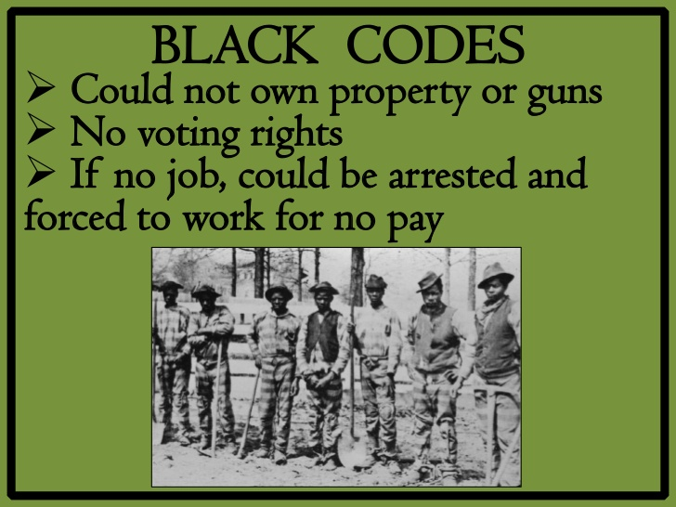
9.2 Radical Reconstruction
I. Southern states ratified the 13th Amendment, but enacted black codes.
A. Black codes- African Americans could marry and own property, but couldn’t vote, own guns, serve on juries, could only work as laborers or servants forced to sign contracts.
B. Violence and riots against blacks
C. Radical Reconstruction from Republicans in Congress- didn’t want Southerners back in Congress, wanted to control Congress and make the South pay.

Slide 6
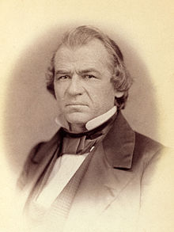
D. 14th Amendment- defines all citizens as “all persons born or naturalized in the U.S.”
equal protection under the law and right to life, liberty, and the pursuit of happiness, any state denying any male citizen the right to vote would lose representation in Congress
E. Military Reconstruction Act of 1867- 5 military districts in the South with North occupation
F. President Johnson didn’t like all these radical acts- treat the South appropriately to avoid conflict- Feb. 1868 the House brought impeachment proceedings against Johnson, by one vote in the Senate, he was not removed from office
https://www.youtube.com/watch?v=H11SE9M2oMY
2 min. PBS Johnson

Slide 7
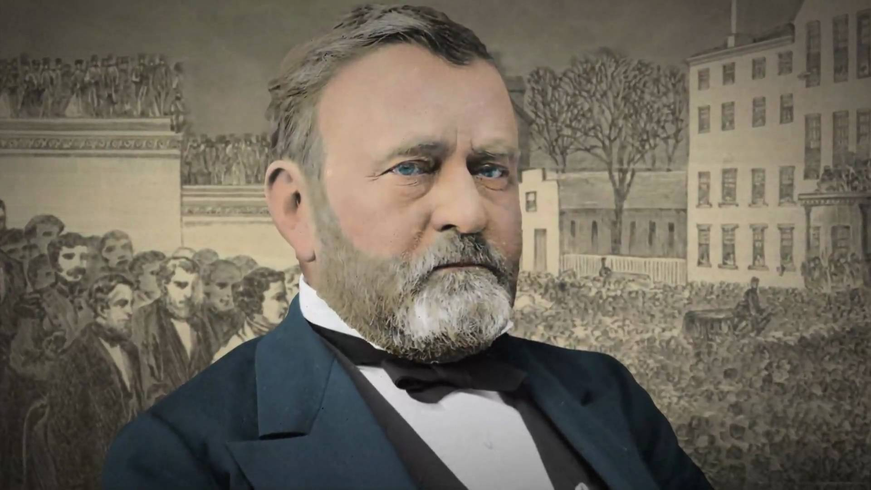
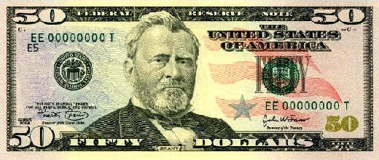
II. Ulysses S. Grant wins the 1868 Presidential election
A. 15th Amendment- forbade any state to deny any citizen the right to vote because of “race, color, or previous servitude”- African American men over 21 had the right to vote.
https://www.youtube.com/watch?v=TX9vO7U_tC4
Grant PBS 2 min

Slide 8
9.3 Reconstruction and the Southern Society
I. New Southern Politics
A. Whites in the South who helped with Reconstruction was called scalawags, Northerners that went to the South after the war to prey on the South’s misery and to get rich were called carpetbaggers
B. African Americans were elected to office and became public servants.
C. Hiram Rhodes Revels- 1870-first black senator
D. Southerners wanted the whites to remain in power- created secret societies to help whites retain power- Ku Klux Klan – KKK- burned crosses murdered hundreds of blacks and white allies- frightened blacks from voting
E. Tax increases to help rebuild the South

Slide 9
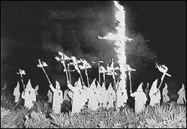
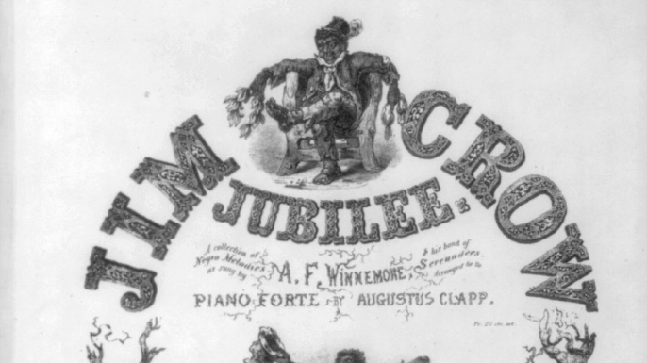
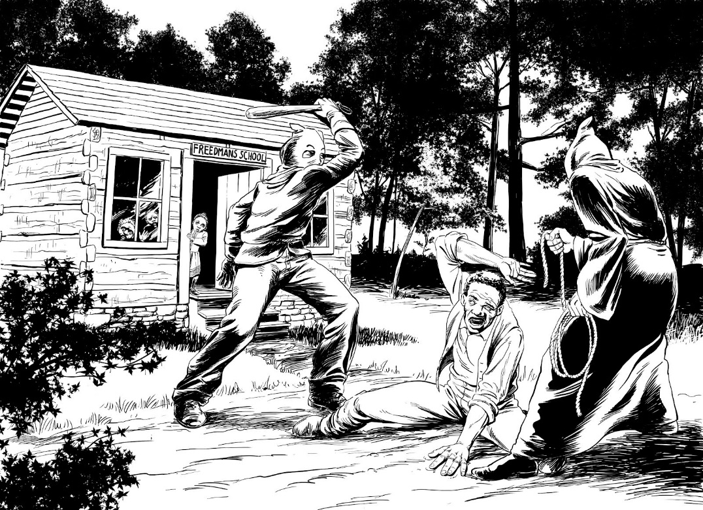
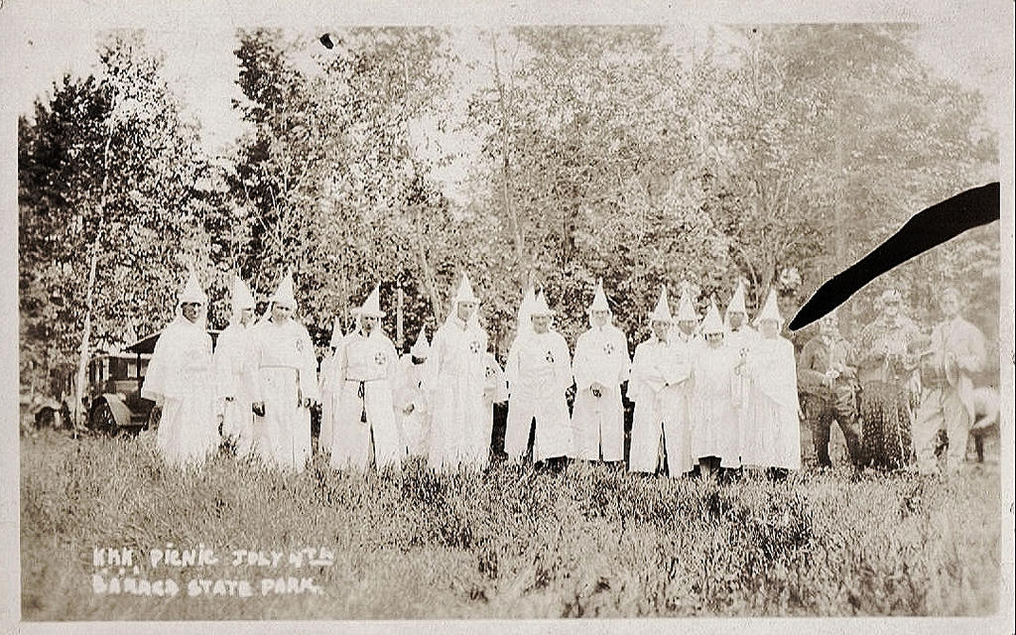

Slide 10
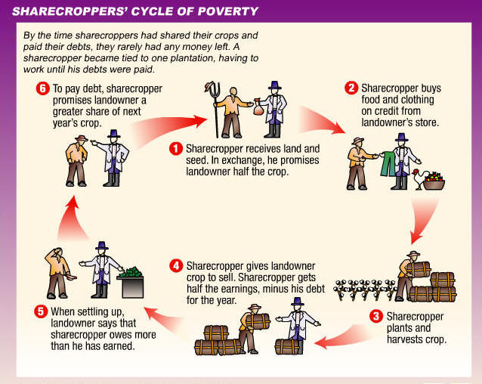
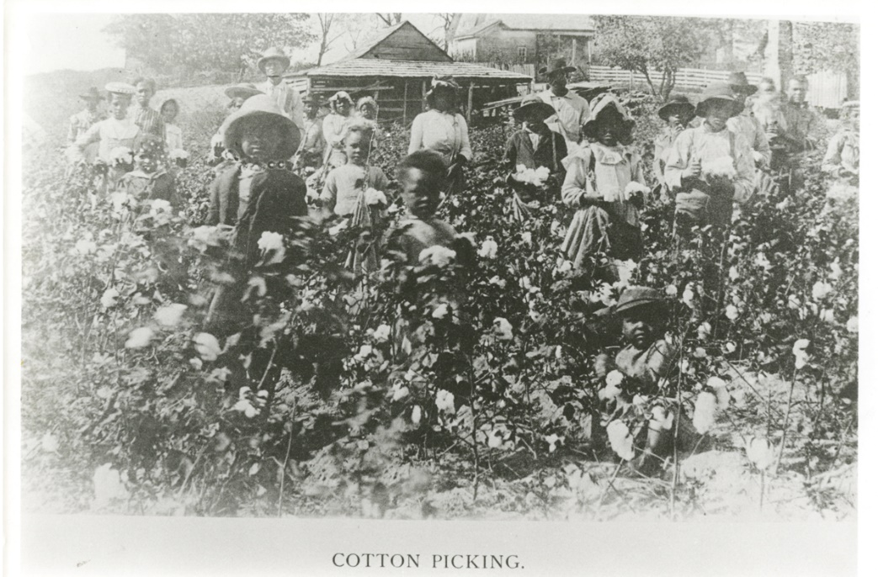
II. Economic Problems for Freedman
A. Many freedman couldn’t afford land, so worked on the plantations for low pay.
B. Sharecroppers rented a plot of land and the owners (planters) provided seed, fertilizer, and tools in return for a share of the crop at harvest time. This resulted in cycles of poverty where the sharecroppers were tied to the land constantly owing money to the landowners.
C. More competition for Southern products from outside US- tobacco, cotton, sugarcane etc…

Slide 11
9.4 The Aftermath of Reconstruction
I. President Grant appointed some friends to positions for Reconstruction and they stole money. Many people sick of Reconstruction.
A. Amnesty Act- 1872- restored the right to vote to nearly all white southerners.
B. 1876 Presidential Election no majority winner- disputed ballots, so a commission appointed to decide the disputed ballots. The Compromise of 1877 basically said the South would go with the Commission’s decision of backing Rutherford B. Hayes if Reconstruction ended in the South.

Slide 12
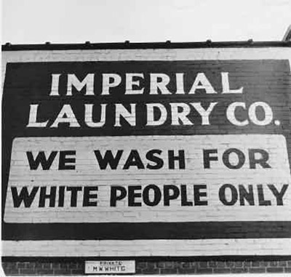
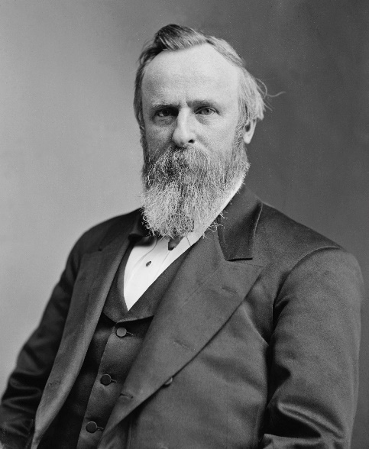
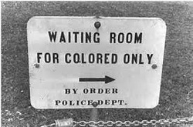
C. Rutherford B. Hayes wins the disputed 1876 election and ends Reconstruction- all troops left the South. White Southerners bitter- many blacks lost some political rights.
D. Southern Democrats found ways to restrict blacks- poll taxes, literacy tests, and the grandfather clause.
E. Jim Crow laws- 1877- segregation became law in the South- separated blacks and whites in schools, restaurants, theaters, trains, hospitals, cemeteries etc…
F. Plessy v. Ferguson- 1896- Supreme Court decided separate but equal facilities was constitutional.

Slide 13
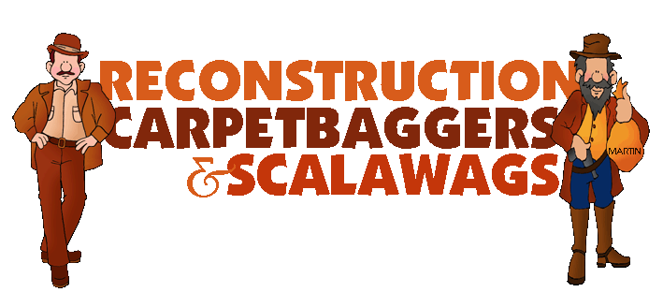
II. The South built its economy back up by 1880- new industries (factories and mills) and good farm production and new resources found and utilized- factories, farming, and mining South developed a more balanced economy by 1900- not solely based on farming like the past
https://www.youtube.com/watch?v=BJLBrDSTgng
14 min. Reconstruction PBS

