Slide 1
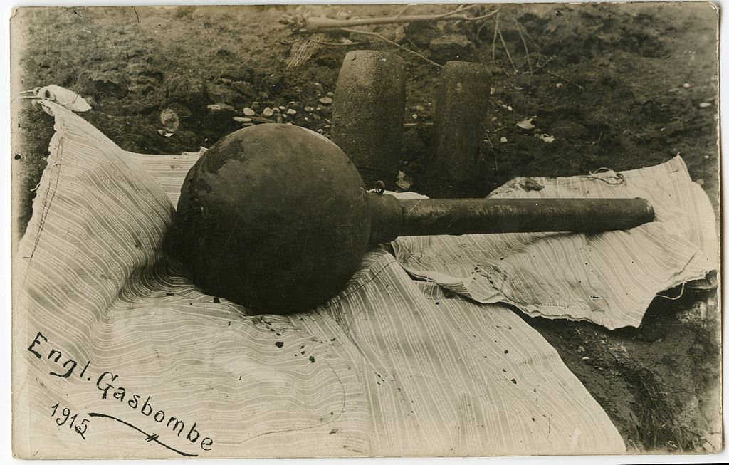

Slide 2
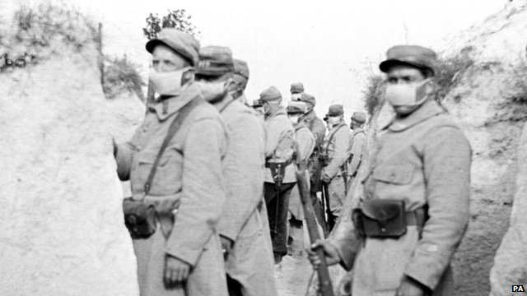
When the Germans launched the first gas attacks in 1915, the allies were desperate to find out what chemicals were used and how they could protect troops in the front line. The War Office called in an Oxford academic to help - a man who was prepared to put his own life at risk to produce the first gas mask. http://www.bbc.com/news/uk-england-oxfordshire-25843294

Slide 3
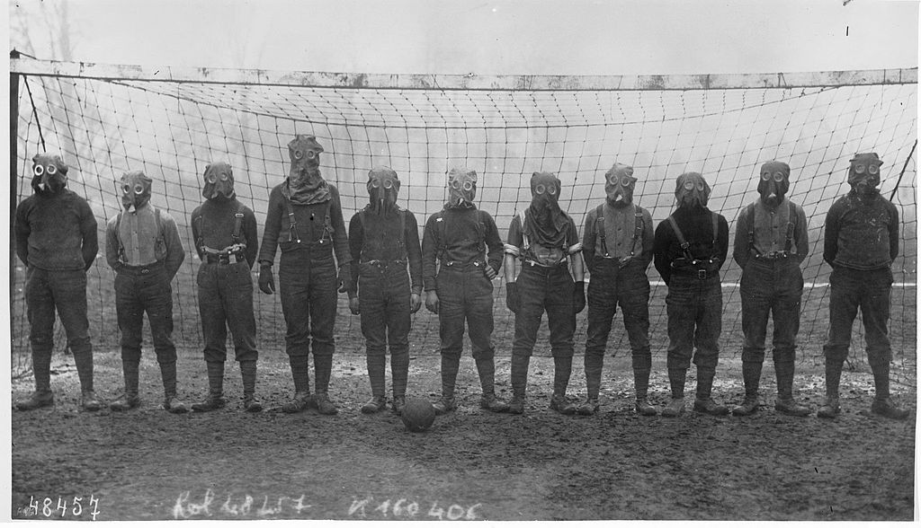
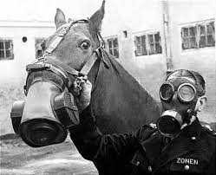
Examples of the evolving gas masks. Soldiers had been told to improvise primitive protection,
including soaking socks in their own urine and tying them around their faces. http://www.omgfacts.com/lists/5284/During-World-War-
Ihomemade-gas-masks-were-made-by-peeing-on-a-cloth

Slide 4
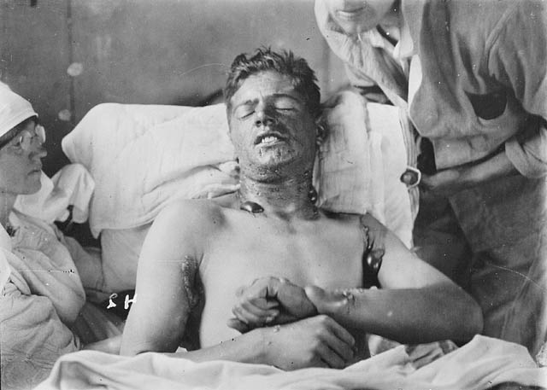
Canadian Soldier with Mustard Gas Burns

Slide 5
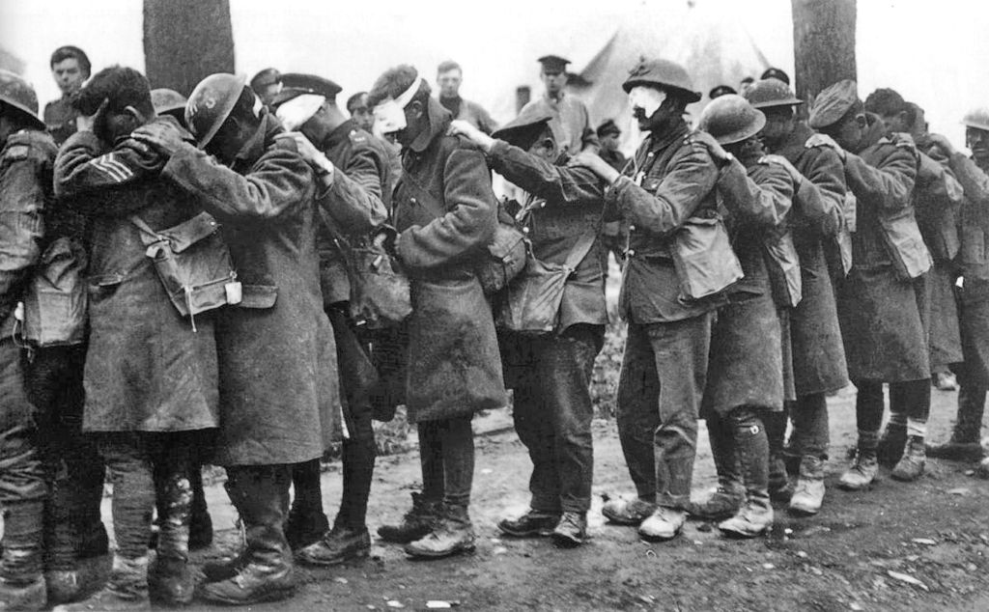
British troops blinded by tear gas during the Battle of Estaires, 1918
http://en.wikipedia.org/wiki/Chemical_weapons_in_World_War_I

